Slide 1
Real Time Video Analysis
By Pooja Shekhar(23)

Slide 2
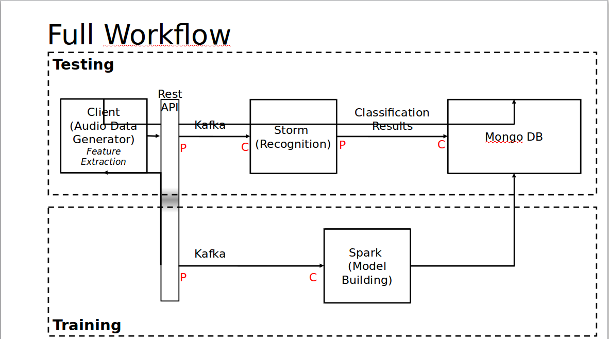
System Architecture

Slide 3
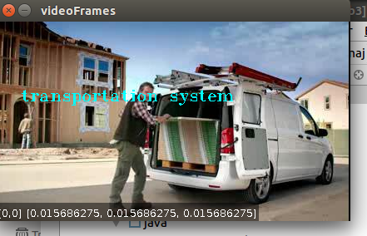
Scene Categorization
Scene Categorization is a term that is usually used to refer to the problem of recognizing the semantic label (e.g. travel, home, transportation etc.) of a single image. This project designs a technique to identify the categories of a scene

Slide 4
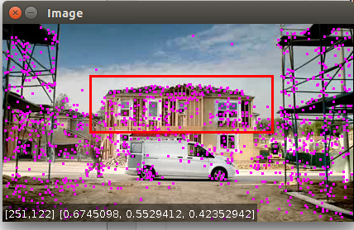
Other Objectives
Object Tracking
Image Classification
CONFUSION MATRIX:
F-MEASURE: 0.6817523304581611
RECALL: 0.6573731944910984
PRECISION: 0.7384695474593782
Predicted Actual | home | man | car
Home | 166.0 | 63.0 | 47.0
Man | 281.0 | 1427.0 | 405.0
Car | 84.0 | 140.0 | 364.0

Slide 5

Url: https://youtu.be/Zb6K8MzWvN4

Slide 6


